Slide 1

Implementation and Components in Data Warehouse
Overview , Architecture & Benefit
Name: Shubham Umesh Chavan
Topic: Datawarehouse Components

Slide 2
Agenda
Core Components of a Data Warehouse
Operational Source Systems
Load Manager
Warehouse Manager
Query Manager
Detailed Data
Archive and Backup Data
Metadata

Slide 3
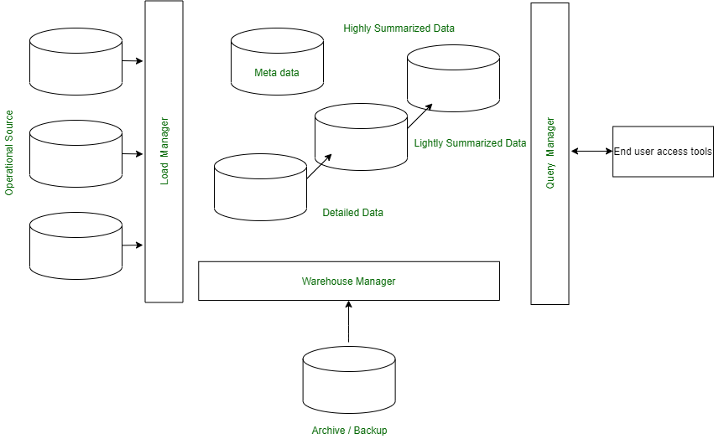
Core Components of a Data Warehouse

Slide 4
Operational Source Systems
Serve as the primary input for the data warehouse
Load Manager
Prepares data for entry into the warehouse, ensuring
it meets the required format.
It ensures that data is loaded accurately, efficiently, and securely.
Warehouse Manager
It focuses on data storage, consistency, performance, and maintenance
Query Manager
It acts as a bridge between users and the warehouse data

Slide 5
Detailed Data
It is collected directly from operational source systems before heavy aggregation.
Archive and Backup Data
reduce storage cost and improve performance
Metadata
It describes the structure, meaning, origin, and usage of data stored
in a data warehouse.
.

Slide 6


